Slide 1


An in-depth look at…
The ESYL Scheme
Notes:
Talk about the importance of YLs

Slide 2
Do more. Be more
Some Questions…
How many young leaders do you have?
How do young leaders fit into your group?
What do you want to know more about?

Slide 3
Do more. Be more
Overview
The YL scheme – a quick glance
The YL journey
Pushing your YL
Running a module
Do more.
Be More
Young Leaders’ Scheme

Slide 4
Do more. Be more
The YL Scheme – A Quick Glance
“ESYLs are a brilliant asset to any section. They diversify the leadership team and bring fresh ideas and inspiration to the table. With the right development, they can become fantastic section leaders, ensuring that even more young people in the future benefit from the adventures, friendship and skill development Scouting brings.”

Slide 5

The Young Leaders Scheme – A Quick Glance
Module A - Prepare for take-off (essentials and expectations)
Module B - Taking the lead
Module C - That’s the way to do it!
Module D - Understanding behaviour
Module E - Game on!
Module F - Making Scouting accessible and inclusive
Module G -What is a high-quality programme?
Module H - Programme planning
Module I -What did they say?
Module J - Communicate it!
Module K- First aid masterclass
4 Missions: Games, Activity, Programme Planning and Delivery
Notes:
Briefly explain the premise of each module

Slide 6


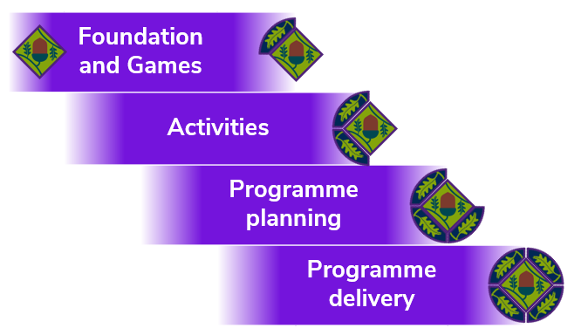
The Young Leaders Scheme – A Quick Glance
Missions
Notes:
Briefly explain the missions.

Slide 7

The Young Leaders Scheme – A Quick Glance
The Explorer Scout Young Leader Logbook
Notes:
Explain the top award and the importance of a logbook, make sure Yls have one!

Slide 8
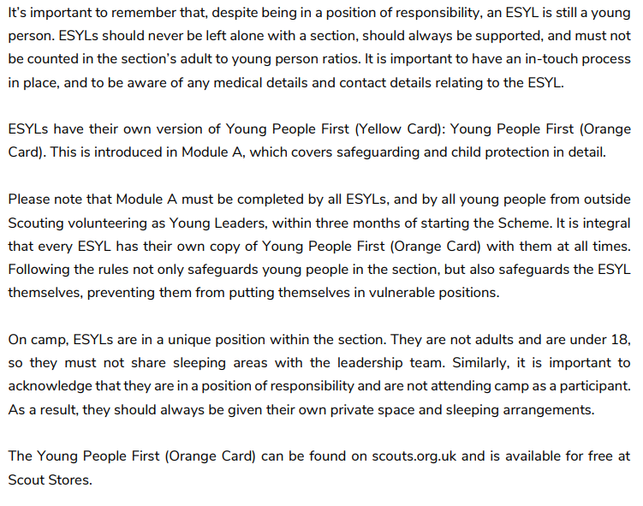

The Young Leaders Scheme – A Quick Glance
Safeguarding
Notes:
Explain the top award and the importance of a logbook, make sure Yls have one!

Slide 9
Do more. Be more
The YL Journey

Slide 10
The YL Journey
Starting Out
Development
Progression

Slide 11
The YL Journey
Starting Out
REGISTER
ESYLs must be registered as an explorer with Steve Crocker and myself before or on their first session as a Young Leader, this is usually on OSM and confirmed by email.
YLs are explorers, they have the option to attend an explorer unit, but they do not have to. This is organised by leaders or parents by contacting the explorer unit directly.

Slide 12
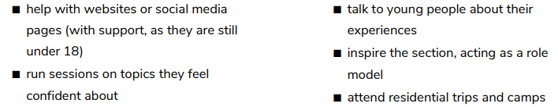
The YL Journey
Starting Out
GETTING THEM INVOLVED
Get to know your YL and encourage them to get to know the young people. This can be done by asking them to run a game for example.
Make sure to coach your YL in running activities and games, invite them to planning meetings. Provide as many opportunities to get involved as you can!

Slide 13
The YL Journey
Starting Out
Development
Progression

Slide 14
The YL Journey
Development
Training and Missions
Training is run by myself on a district level – but any module (apart from Module A) and missions can be run locally in groups… more on this later!
Online modules are accessible in the 14-18 area on the district website. Missions are very easy to do – and are often part of what your YL does already.
Remember to reward these with badges!!

Slide 15

The YL Journey
Development
Youth Led Scouting
YLs are in a unique position – young people in your group will relate and and be open with them.
Utilise your young leaders to connect with your sections and run forums to gain an idea of what your sections want in their programme.
Coach YLs and recognise their strengths, utilise them in your planning, games and ideas.

Slide 16
The YL Journey
Starting Out
Development
Progression

Slide 17

The YL Journey
Progression
DofE
Young people can be external to scouting and join the ESYL scheme as part of their volunteering in the DofE.
This means that YLs that come through from Scouts or from an Explorer unit can use the ESYL scheme to get ahead in the DofE. We’re in the process of setting up a DofE scheme in the district.

Slide 18
The YL Journey
Progression
Adult Leaders
ESYL training contributes to adult leader training and is counted as prior learning to the modules!
Young leaders who are positively engaged in the ESYL scheme often wish to become adult leaders.
This can be seen almost as an investment opportunity, not only can you utilise young leaders when you’re low on adult leaders, but you can also expect more adult leaders in the future.
ESYLs also have an edge for any district role applications.

Slide 19
The YL Journey
Progression
The Future
The ESYL scheme provides an advantage to young people looking for further education opportunities and jobs.
After a year as an ESYL they’re entitled to a reference from the district explaining their efforts as an ESYL, whether this be a university application or job. (In some cases, it might be best to come from the GSL).

Slide 20
Do more. Be more
Pushing Your YL

Slide 21
Do more. Be more
Running a Module

Slide 22
………………………………………………………………………………………………………………………………………………………………………………………………………………………………………………………………………………………………………………………………………………………………………………………………………………………………………………………………………………………………………………………………………………………………………………………………………………………………………………………………………………………………………………………………………………………………………………………………………………………………………………………………………………………………………………………………………………………………………………………………………………………………………………………………………………………………………………………………………………………………………………………………………………………………………………………………………………………………………
The formula.
It would be a very long day if we sat here and went through the programme for every module!
Instead, we can look at the process of running modules in house – a very beneficial process for pushing your YLs to achieve their top award.
Every group is different, see what works for you!
Module A cannot be run in-house.
Module
Resources
Plan
Record
Engage

Slide 23
Resources
Resources – Reduce Your Workload!
Use The Scouts website to look at how to run the module. Modules should have a session plan and PowerPoint for you.
Email myself – I may have a plan ready or be able to provide tailored ideas!

Slide 24

Plan
Plan – Be Prepared!
Using the resources, you’ve looked at, think about how you are going to execute the module.
Module | Indoors | Outside | 1:1
B – Lead
C – The way
D – Behaviour
E – Game on!
F – Inclusive
G – Programme
H – Planning
I – Listening
J - Communicate

Slide 25
Record – Keep it simple!
Please notify myself of any modules completed in house, and the YLs who took part.
Keep a record of who has completed what module. You can award modules to young people on OSM.
YLs should use their logbook to record their own modules and fill it out – the logbook has to be fully completed to earn the ESYL belt buckle.
Record

Slide 26
Engage – Keep it going
Modules can be interesting and fun - they push your YL to build potential.
Use the missions and keep in touch with district events where YLs can meet from other groups.
Engaged YLs will better support your group, be a big part of the sections programme and build up your Leader numbers.
Engage

Slide 27
Let’s have a final discussion about the ESYL scheme

Slide 28
We’re nearly there…
What questions have been answered for you?
What questions do you still have?
What is one thing you will be actioning in your group?

Slide 29
Thank you
Young Leader Scheme
ben.barlow@wolverhamptonnorthscouts.org.uk

